Slide 1
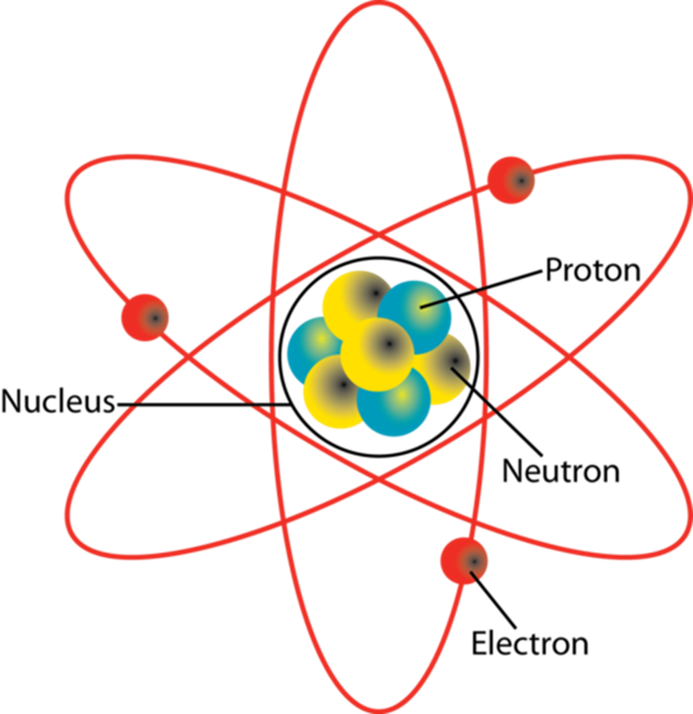
Daily Review
CFU 1
Which subatomic particles are found in the nucleus?
CFU 2
Which subatomic particles are negatively charged?
Structure of an Atom
Atoms are made of three subatomic particles: protons, neutrons and electrons.
Protons and neutrons are found in the centre of an atom, which is called the nucleus.
Electrons orbit the nucleus at very high speeds.
Some subatomic particles have electrical charges:
Protons have a positive (+) charge
Electrons have a negative (-) charge
Neutrons are neutral and have no charge
CFU 3
How are protons and electrons different to neutrons?
CFU 4
How are protons and neutrons different to electrons?
Vocabulary
Subatomic: smaller than, or occurring within, an atom

Slide 2
Daily Review
CFU 1
What determines which type of element an atom is?
Structure of an Atom
The number of protons in the nucleus of an atom determines which element the atom is.
All atoms of an element have the same number of protons.
For example, all carbon atoms have 6 protons.
This is referred to as the atomic number of the element.
CFU 2
An element has an atomic number of 32. How many protons are in its nucleus?
CFU 3
What is the atomic number of the atom in the picture? How do you know.
Vocabulary
Subatomic: smaller than, or occurring within, an atom

Slide 3
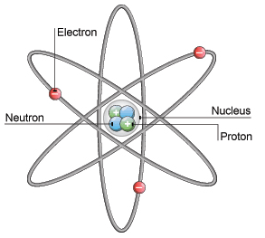
Daily Review
Describing the Structure of an Atom
State the number of protons and neutrons in the nucleus. State the number of electrons orbiting the nucleus. State whether the atom is neutral or charged. neutral = number of protons and electrons is equal charged = number of protons and electrons is not equal
Describe the structure of the helium atom.
There are ___ protons and ___ neutrons in the nucleus.
There are ___ electrons orbiting the nucleus.
The atom is ________ because __________.

Slide 4
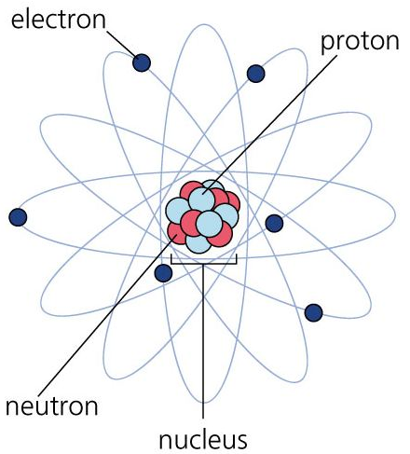
Daily Review
Describing the Structure of an Atom
State the number of protons and neutrons in the nucleus. State the number of electrons orbiting the nucleus. State whether the atom is neutral or charged. neutral = number of protons and electrons is equal charged = number of protons and electrons is not equal
Describe the structure of the carbon atom.
There are ___ protons and ___ neutrons in the nucleus.
There are ___ electrons orbiting the nucleus.
The atom is ________ because __________.

Slide 5
Isotopes and Atomic Mass Year 9 Chemistry

Slide 6
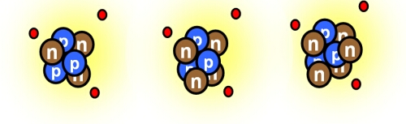
Learning Objectives
CFU
What are we going to learn?
Define isotopes of an element.
Calculate atomic mass for isotopes.
Write atomic symbols for isotopes.
Activate Prior Knowledge
Look at the diagrams of the three lithium atoms.
Think, Pair, Share: How are these three atoms similar? How are they different?

Slide 7
Concept Development
CFU 1
Where would an electron be located?
Structure of Atoms
Atoms are made of three subatomic particles: protons, neutrons and electrons.
Protons and neutrons are found in the centre of an atom, which is called the nucleus.
Electrons orbit the nucleus at very high speeds.
CFU 2
What charge would the nucleus of an atom have?
CFU 3
What does the phrase “subatomic particle” mean?
Vocabulary
Subatomic: smaller than, or occurring within, an atom

Slide 8
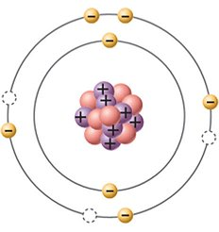
Concept Development
CFU 1
What is similar about all atoms of an element?
Atomic Number
Atoms of the same element all have the same number of protons in their nucleus.
The number of protons is called the atomic number.
For example, all atoms of carbon have 6 protons, so its atomic number is 6.
CFU 2
Fluorine’s atomic number is 9. How many protons does it have?
CFU 3
Is the atom shown a carbon atom? Explain why or why not.
Vocabulary
Subatomic: smaller than, or occurring within, an atom

Slide 9
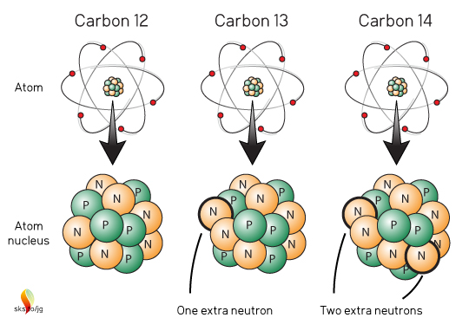
Concept Development
CFU 1
What in the nucleus of an element can change?
Isotopes
Atoms of the same element all have the same number of protons, but the number of neutrons can be different.
Atoms of the same element with different numbers of neutrons are called isotopes.
For example, carbon isotopes all have 6 protons, but they have different numbers of neutrons (6, 7, and 8).
CFU 2
Explain what is meant by the term ‘isotope’.
CFU 3
Why are the three atoms shown classified as isotopes?
Vocabulary
Subatomic: smaller than, or occurring within, an atom

Slide 10
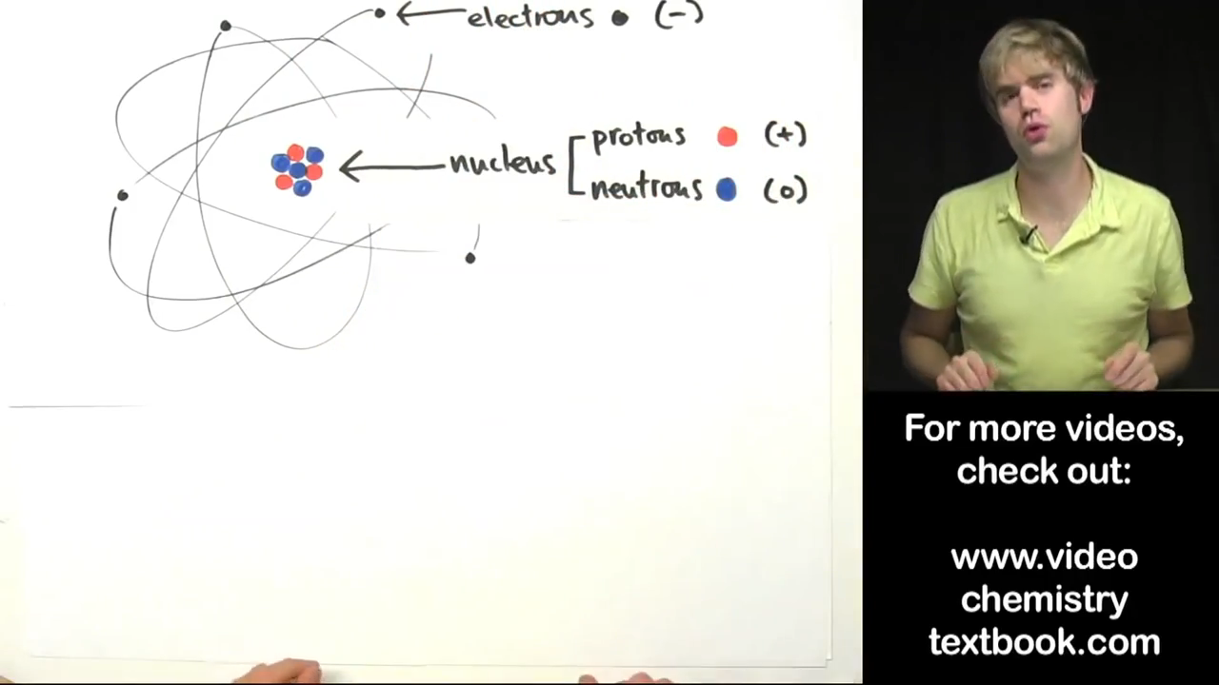

Slide 11
Concept Development
CFU 1
What determines the mass of an atom?
CFU 2
Why are electrons not included in the atomic mass?
Atomic Mass
The mass of an atom is determined by the mass of its nucleus.
Electrons are so light compared to protons and neutrons that they are usually not considered.
On the relative atomic scale, protons and neutrons both have masses of approximately 1 amu (atomic mass unit).
This allows us to work out the total mass of an atom by adding the number of protons and neutrons.
CFU 3
How do you find the atomic mass of an atom?
CFU 4
What is the atomic mass of the atom in the picture? How do you know?
Vocabulary
Subatomic: smaller than, or occurring within, an atom
Notes:
1.007 (p) and 1.009 (n) if you want to be more exact

Slide 12
Concept Development
CFU 1
What is the atomic mass number of each of these carbon atoms?
Atomic Mass Number
The mass number of an atom is found by adding the number of protons and neutrons.
Different isotopes are written with their atomic mass numbers after the element name, e.g. helium-4 or helium-5.
CFU 2
Write the name of each carbon isotope below.

Slide 13
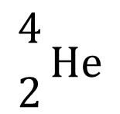
Concept Development
CFU 1
What three things does an atomic symbol include?
Atomic Symbols
An atomic symbol is a way of representing a specific isotope of an element.
An atomic symbol always includes:
The symbol of the element
The atomic number (in front of and below the element symbol)
The mass number (in front of and above the element symbol)
This helium atom can be represented as:
CFU 2
Where is the atomic number written?
CFU 3
Write the atomic symbol for the lithium atom at the top of the slide.
mass number (protons + neutrons)
$${4 \atop 2}\text{He}$$
Vocabulary
Subatomic: smaller than, or occurring within, an atom
atomic number (protons)
element symbol

Slide 14
Concept Development
CFU 1
With the person next to you, write the atomic symbol for each of the carbon atoms.
Atomic Symbols
An atomic symbol always includes:
The symbol of the element
The atomic number (in front of and below the element symbol)
The mass number (in front of and above the element symbol)
Vocabulary
Subatomic: smaller than, or occurring within, an atom

Slide 15
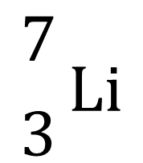
Skill Development / Guided Practice
CFU 1
What is the element symbol?
Representing Isotopes as Atomic Symbols
Write the element symbol. Count the number of protons and write the atomic number in front of and below the element symbol. Add up the number of protons and neutrons and write the mass number in front of and above the element symbol.
CFU 2
What is the atomic number?
CFU 3
What is the mass number?
Write an atomic symbol for this lithium isotope.
$${7 \atop 3}\text{Li}$$

Slide 16
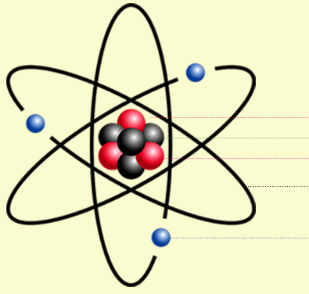
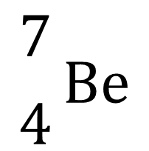
Skill Development / Guided Practice
CFU 1
What is the element symbol?
Representing Isotopes as Atomic Symbols
Write the element symbol. Count the number of protons and write the atomic number in front of and below the element symbol. Add up the number of protons and neutrons and write the mass number in front of and above the element symbol.
CFU 2
What is the atomic number?
CFU 3
What is the mass number?
Write an atomic symbol for this beryllium isotope.
$${7 \atop 4}\text{Be}$$
Proton
Neutron
Electron

Slide 17
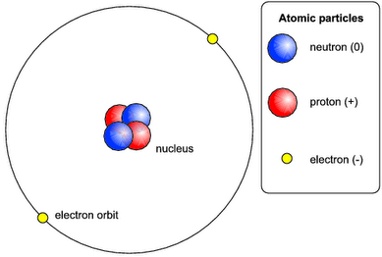
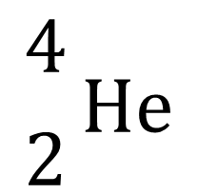
Skill Development / Guided Practice
CFU 1
What is the element symbol?
Representing Isotopes as Atomic Symbols
Write the element symbol. Count the number of protons and write the atomic number in front of and below the element symbol. Add up the number of protons and neutrons and write the mass number in front of and above the element symbol.
CFU 2
What is the atomic number?
CFU 3
What is the mass number?
Write an atomic symbol for this helium isotope.
$${4 \atop 2}\text{He}$$

Slide 18
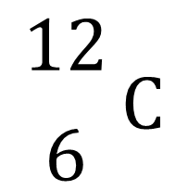
Skill Development / Guided Practice
CFU 1
What is the element symbol?
Representing Isotopes as Atomic Symbols
Write the element symbol. Count the number of protons and write the atomic number in front of and below the element symbol. Add up the number of protons and neutrons and write the mass number in front of and above the element symbol.
CFU 2
What is the atomic number?
CFU 3
What is the mass number?
Write an atomic symbol for this carbon isotope.
$${12 \atop 6}C$$

Slide 19
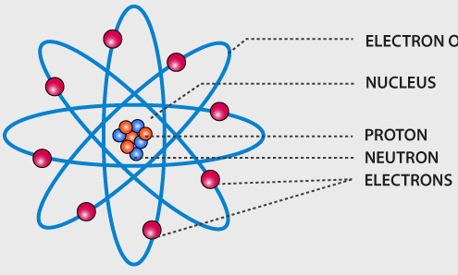
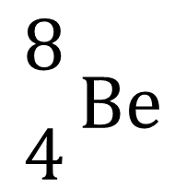
Skill Development / Guided Practice
CFU 1
What is the element symbol?
Representing Isotopes as Atomic Symbols
Write the element symbol. Count the number of protons and write the atomic number in front of and below the element symbol. Add up the number of protons and neutrons and write the mass number in front of and above the element symbol.
CFU 2
What is the atomic number?
CFU 3
What is the mass number?
Write an atomic symbol for this beryllium isotope.
$${8 \atop 4}\text{Be}$$

Slide 20
Relevance
Different isotopes of an element can have different properties. For example:
Uranium-235 can fuel nuclear reactors and weapons, while the much more common uranium-238 cannot.
Heavy water, which contains hydrogen-2 instead of hydrogen-1, is needed to run some types of nuclear reactors.
Atomic mass explains why some elements are heavier than others.
Understanding atomic symbols will help you represent isotopes clearly.

Slide 21
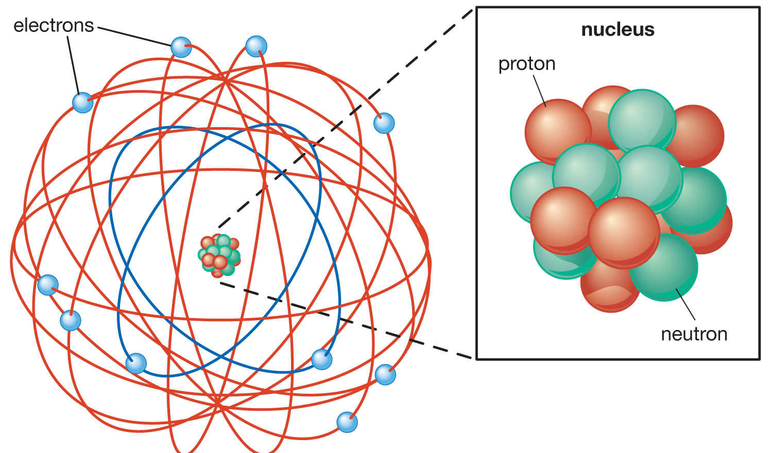
Skill Closure
Representing Isotopes as Atomic Symbols
Write the element symbol. Count the number of protons and write the atomic number in front of and below the element symbol. Add up the number of protons and neutrons and write the mass number in front of and above the element symbol.
What is an isotope?
Skill Closure
Which subatomic particles of an atom are used to calculate its mass? Why is the other subatomic particle not included?
Skill Closure
+
+
+
+
Write the atomic symbol for the fluorine isotope.
+
+
+
+
+

Slide 22
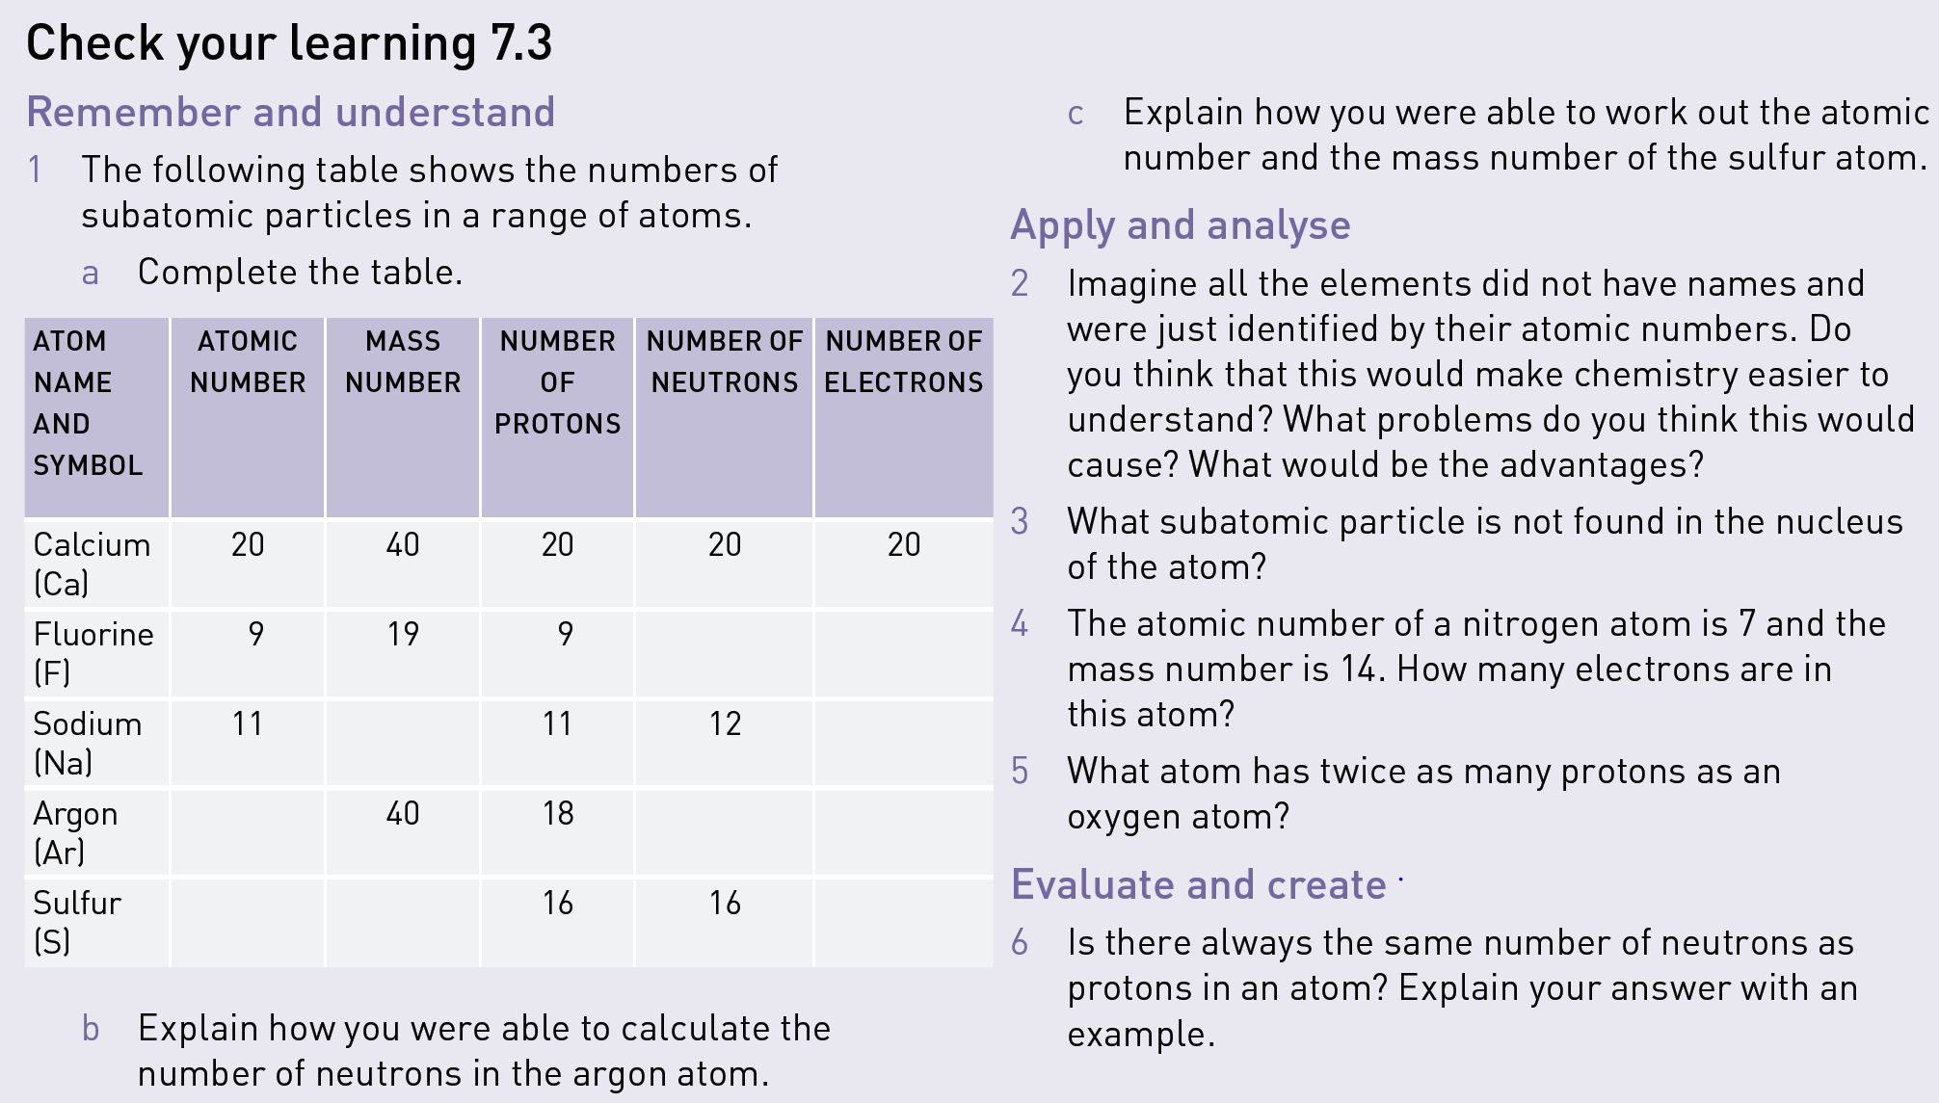
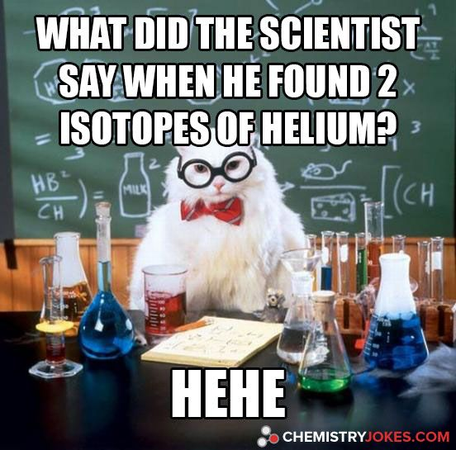
Independent
Practice
Complete the text book questions on page 139.
Add another column to the table in Q1 and write atomic symbols for each atom.

